Slide 1
Big Mountain Resort Problem Identification
<Wenrui Huang 091621>
H
1
Context
4
Constraints within solution space
Big Mountain Resort, a ski resort located in Montana with 105 trails and yearly average 350K visitors recently installed a new chair lift. The new lift has increased operating cost by $1, 540, 000 this season and thus a premium has been charged on the ticket. The management would like to implement changes that will reduce the cost without negatively affecting the ticket price.
Lacking the itemized breakdown of operating cost
Safety concerns regarding running on full capacity
Competitions from other ski resorts / customers’ preference
Weather conditions / potential restrictions / shutdown due to COVID
Situations in other resorts may not be applied to this one.
2
Criteria for success
5
Stakeholders to provide key insight
Facilities at Big Mountain Resort are fully capitalized so that the operating cost are reduced without undermining the current ticket price. Expecting reduction in overall cost at least 20% by the end of 2021.
Business / Management
Supervisor / Coworkers at Data Science Team
Investors / Share holders
3
Scope of solution space
6
Key data sources
Metadata sets on 330 resorts across the US provided through database manager
Maintenance logs to understand the operating cost composition of the resort (might be available from the management)
Survey to obtain the the preference of the visitors on resort facilities.
Analyzing will be mainly focused on the datasets on all 330 resorts across the US to identify competitive advantages of THIS resort to determine which changes to implement in order to reduce operating cost while maintaining similar or higher ticket price.
H
D
E
I
P
Notes:
Hypothesis: Create a Hypothesis with an emphasis on SMART principles. (S – Specific, M – Measurable, A – Achievable, R – Realistic, T – Timebound). If you cannot do this, you do not have a good grasp on the business problem.
Context: With context, we have clearly identified the problem at hand and have elucidated on how our initiative may solve this problem, alongside the commercial implications this will have on the business.
Criteria for Success: Clearly defining the criteria for success ensures that the scope of your work is clearly defined and understood. Otherwise, if this isn’t defined – your work will never end which will result in mismatched expectations.
Scope of Solution Space: Scoping out the solution space ensures that the business initiative is SPECIFIC for a certain segment or area. This prevents solutions that have been developed being scaled and applied for all other business units that the solution may not be responsible or scalable for.
Constraints within Solution Space: Looking forward, what are the foreseeable problems we are likely to encounter? Could this be stakeholder resistance? Could this be we don’t have access to the right data?
Stakeholders to provide key insight: Who are the people I need to speak to, to get the answers I need for my data analysis?
What key data sources are required?
Based off my discussions with the key stakeholders – can we clearly list out all the data sources we need so we can make a highly targeted request as opposed to a scatter-gun approach where we ask for a bit of everything?

Slide 2
Recommendation and Key findings
Recommendations:
Close five existing runs and open a new run (or Close 4 runs instead)
Increase the current vertical drop by 150 feet
Installing an additional chair lift
Increase ticket price by 2 dollars
Key findings:
Tickets prices of resorts across nations are dominant by four factors: fastQuads, Runs, Snow Making capacity in acres and vertical drop.
Closing 3-5 runs have the same effects on ticket price, while the predicted price drops drastically after closing the 6th run.
Adding one new run, increase vertical drop by 150 feet and an additional chair lift will boost ticket price by $2 and bring in extra 3.4 million dollars revenue each year.
Increasing Snow Making capacity and extending longest run have minimal effect on ticket price.

Slide 3
Comparison of different models
(Random Forest model were selected)
Model | Training MAE | Test MAE
Dummy regression | 17.92 | 19.14
Linear regression | 10.50 | 11.79
Random Forest regression | 9.64 | 9.54

Slide 4
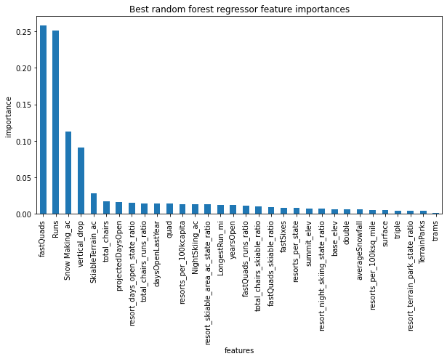
Selected Best Random Forest Regression Model
Hyperparameters for best model:
Number estimators: 69
Impute strategy: median
No scaling

Slide 5
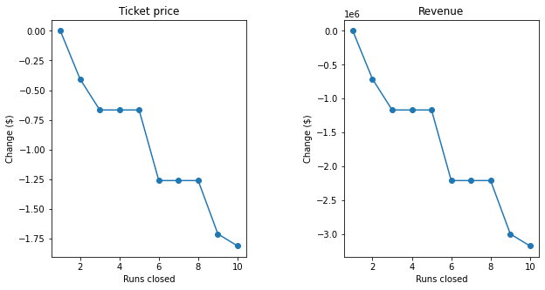
Random Forest regression prediction on Big Mountain Resort
Number of runs closes vs Change in ticket price or revenue
Predicted price: $95.87 Actual price: $81
Number of Closed runs 3-5: ticket price -$0.66, revenue -$1155000
Add a new run plus increase vertical drop plus additional chair lift: ticket price +$1.99, revenue +$3474638
Increase Snow Making ac by 2: no effect
Extend longest run by 0.2 miles: no effect

Slide 6
Summary and Conclusion
Selected random forest regression optimal model successfully predicted ticket prices with a relatively high accuracy.
FastQuads, Runs, Snow Making ac and Vertical drops are dominant features compared to others as demonstrated by the optimal model.
Proposed a strategy on how to reduce operating cost while maintaining similar or higher ticket price by modulating key features in the model.
Itemized operating cost are required for better recommendations.

